Slide 1
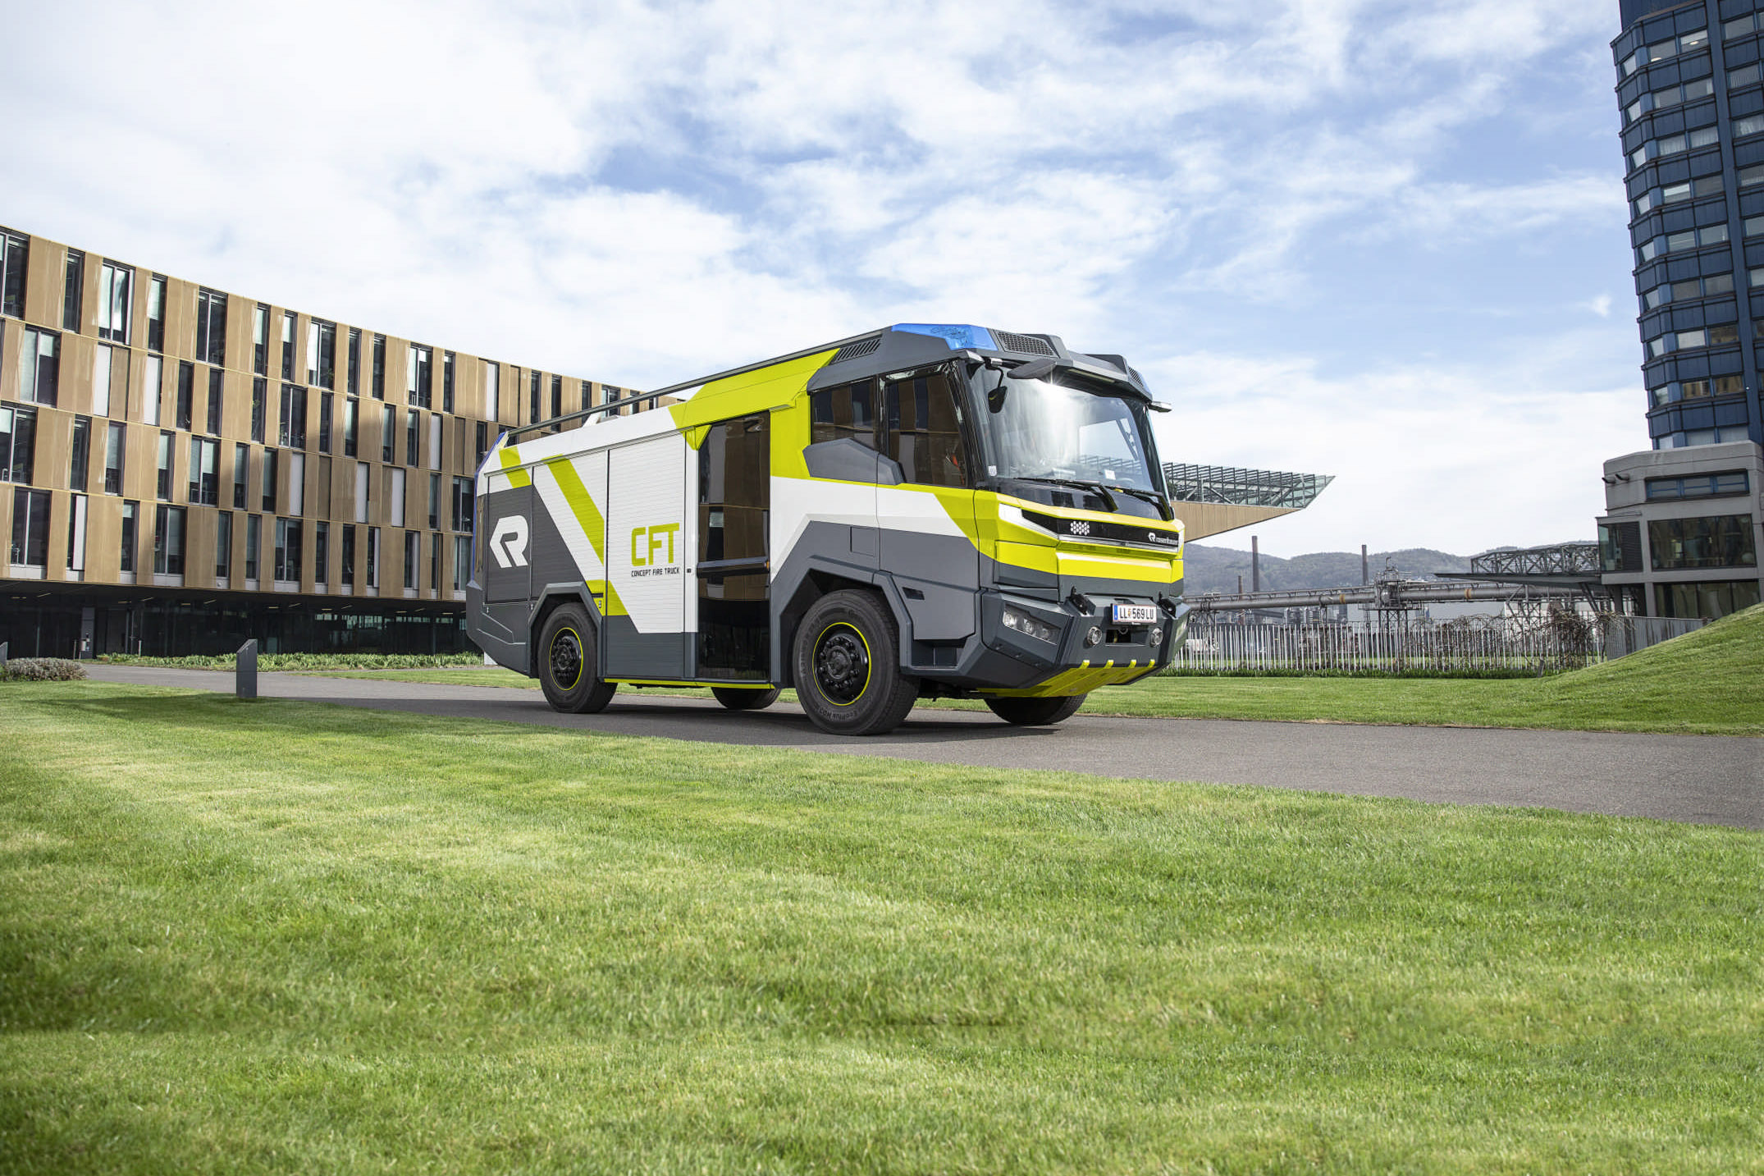

Rosenbauer Group
Rosenbauer Group
Company Roadshow, Toronto
Sebastian Wolf I CFO
April 17, 2019
Person
Date

Slide 2
Disclaimer
This presentation was produced by Rosenbauer International AG (Rosenbauer for short) for informational purposes only. Despite the greatest care taken by Rosenbauer, no guarantee is given for the correctness and completeness of the content.
This presentation may not be reproduced, transmitted, or distributed (neither in its entirety nor in part). Unless otherwise stated, all information (including financial statements and forecasts) is the property of Rosenbauer and may therefore be changed without prior notification by Rosenbauer.
All decisions based on information included in the Rosenbauer presentation are the sole responsibility of the user. Rosenbauer accepts no liability for the actions and consequences resulting from the use of the presentation.
None of the information provided in the presentation constitutes, or is intended to be, an invitation to buy or trade in Rosenbauer shares.

Slide 3

Agenda
Rosenbauer Group at a glance
FY 2018 financial figures
Outlook

Slide 4
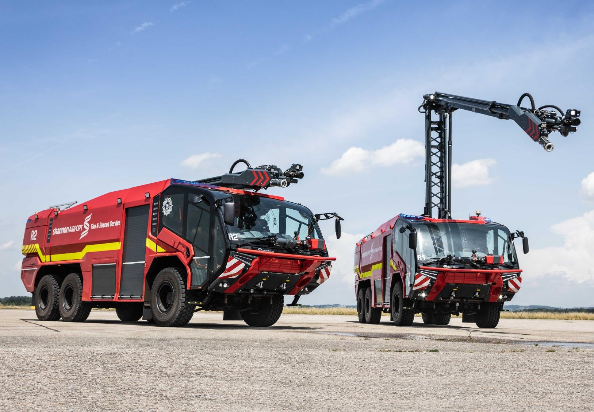
Rosenbauer Group at a glance

Slide 5
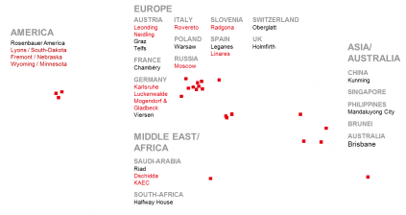
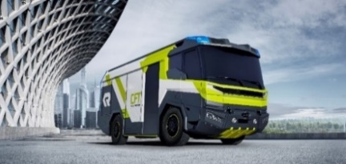
Rosenbauer Group equity story (1/2)
Market Position
Global market leader with exclusive focus on fire fighting equipment and preventive fire protection (full-range supplier)
World´s largest producer of fire fighting vehicles
Solid market positions in Europe, US and Middle East
Present in around 130 countries, around 280 sales partners worldwide
Technology
Industry leader in innovation pioneering sustainability technologies
Traditionally high R&D expenditures, holding currently more than 180 patents
Continuous improvement thanks to an open innovation culture
Develops customer demand actively by defining state-of-the-art

Slide 6
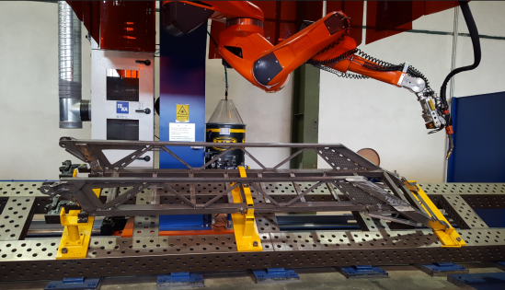


Rosenbauer Group equity story (2/2)
Manufacturing
Unrivalled network of worldwide production facilities, service and sales offices
International manufacturing network with clear competence centers (3 production sites in the US, 9 Europe, 4 Asia)
Production according to EU, US and AUS safety standards
Combines industrial production methods and top-notch engineering
Capital Markets
Resilient business model from high diversification by geographies and products
Strong balance sheet structure
Sustainable dividend policy, safe dividend payments
Organic growth from increasing local market shares and improving profitability

Slide 7







Strategic focus
Our customers´ first choice
Faster and more profitable by repetition effects
from products and processes
Increase of strategic flexibility by utilizing on all potentials
from cost and working capital optimization
Organic growth from well-balanced investments in /
and returns from our strategic market positions
Increase of perceived customer value by means,
which in addition generate economies of scale
Sustainable profits and reinforcement of global market leadership
by scaling up technological leadership and fascinating products
Focus on core business
One Rosenbauer team

Slide 8
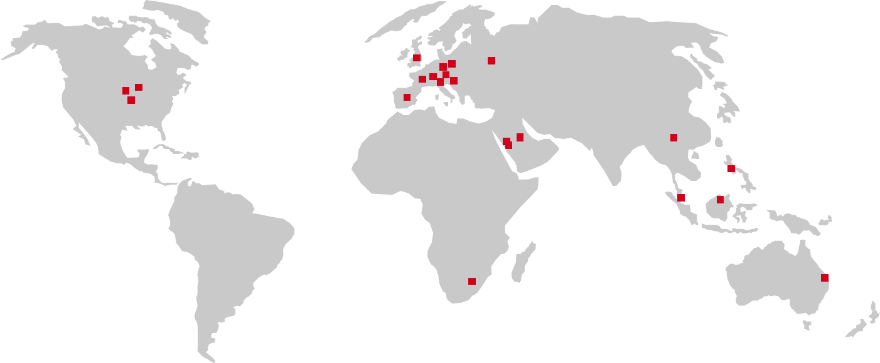
Global network of production facilities, sales and service offices
EUROPE
AUSTRIA Leonding Neidling Graz Telfs
FRANCE Chambéry
GERMANY Karlsruhe Luckenwalde Mogendorf & Gladbeck Viersen
ITALY Rovereto
POLAND Warsaw
RUSSIA Moscow
SLOVENIA Radgona
SPAIN Linares Madrid
SWITZERLAND Oberglatt
UK Holmfirth
AMERICA
Lyons / South-Dakota
Fremont / Nebraska
Wyoming / Minnesota
Rosenbauer America
ASIA/ AUSTRALIA
CHINA Kunming
SINGAPORE Singapore
PHILIPPINES Mandaluyong City
BRUNEI
AUSTRALIA Brisbane
MIDDLE EAST/ AFRICA
SAUDI-ARABIA Dschidda KAEC Riad
SOUTH-AFRICA Halfway House
Production
Sales / Service
Around 280 sales partners worldwide.

Slide 9
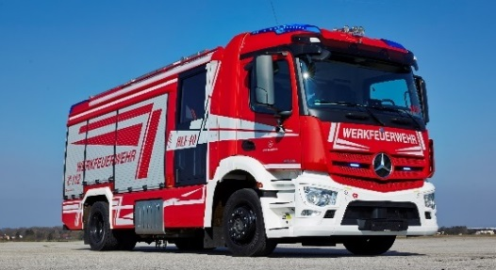
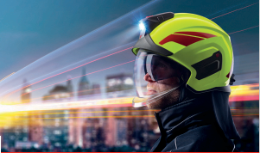
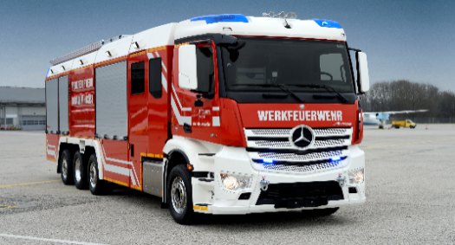
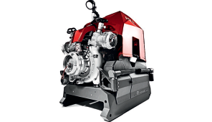
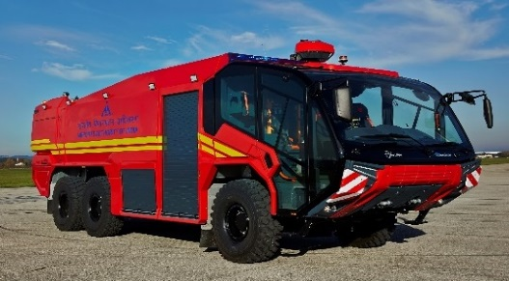
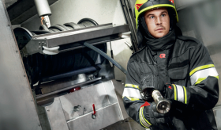
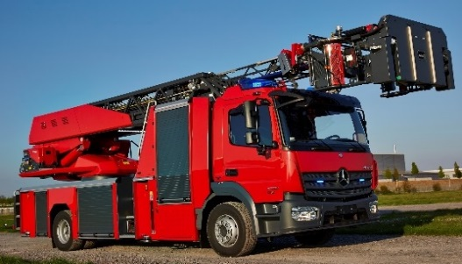
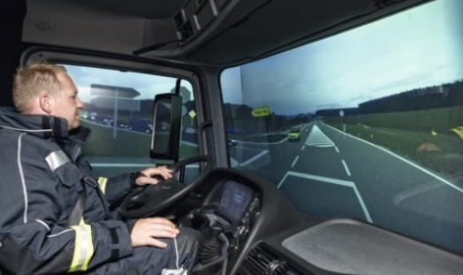
Full-range supplier (Product segments and % of group revenues; as of Dec 31, 2018)
Municipal Vehicles
33%
Fire & Safety Equipment
8%
Industrial Vehicles
12%
Firefighting Components
3%
ARFF Vehicles
11%
Stationary Fire Protection
3%
Aerials
20%
Customer Service
7%
Others 3%

Slide 10
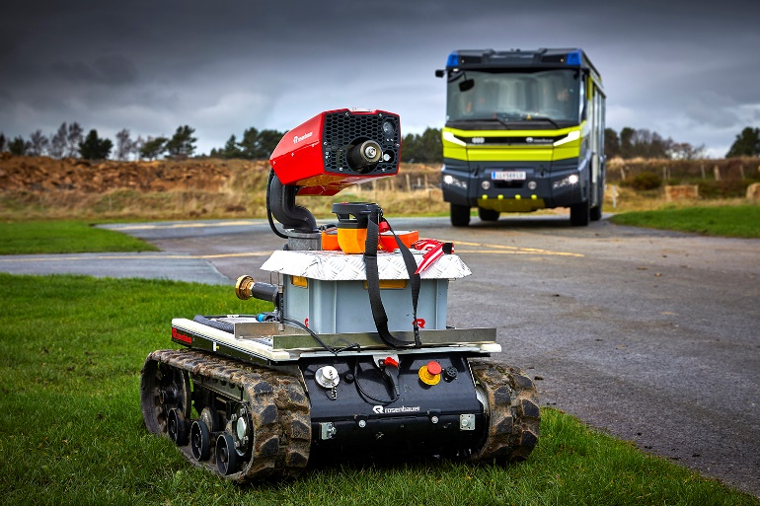
Developing future e-technology
Concept Fire Truck (CFT) on its way to series production readiness
Low emissions based on alternative driving concept
Multi-functionality allows for universal application
Ergonomically optimized expansion through new kind of fire truck architecture
Volvo Penta to adapt proven electronic driveline to the performance requirements of a fire service application
“Innovation partnership” with Berlin Fire Department
Global market for innovative CFT technology to reach around 3,200 vehicles in 2030, with 700 to 800 units running in Europe already by 2025
CFT technology to be transferred also to other types of vehicle
Particular interest from members of the “C40 Cities Climate Leadership Goals”
2019 planned roadshows to Canada, France, Germany, Slovenia, Switzerland and the US
Market launch planned for 2021

Slide 11





Sustainable goals
Compliance | Employees | Products & Society | Ecology & Resources
No breaches of group compliance guidelines and code of ethics | Reduction of accidents at work to 30 per 1 million working hours until 2023 Promotion of diversity and increase of the number of female employees by 25% until 2023 compared to 2018 | Market launch of a firefighting vehicle with an alternative driveline in 2021, which complies with the requirements of a modern fire service Increase sales of training simulators, expand model range Save 100,000 m² plastic foil per year from 2019 on by deploying reusable packaging in the production of firefighter helmets | Raise share of green electricity in the total power consumption of the group to 75% until 2021 Produce own green electricity amounting to 5% of total power consumption until 2021 From 2018 on all coatings are 100% free of heavy metals → goal achieved
Rosenbauer is contributing to the UN Sustainable Development Goals, especially to the ones mentioned below:
Notes:
Strategie und Ziele zu formulieren ist verpflichtend, müssen 2018 wieder berichtet werden sowie Ergebnisse, EY: Ziele müssen genauer definiert werden

Slide 12
Status sustainability goals

Slide 13
Sustainability figures 2018 / 2017
Key figure | 2018 | 2017
Employees | 3,621 | 3,405
Female employees | 11.9% | 12.2 %
Female executives | 13.2% | 10.7 %
Fluctuation | 13.0% | 12.9 %
Sick leave per employee | 10.5 days | 10.3 days
Occupational accidents | 221 = 54.6 / 1 million working hours | 171 = 52.6 / 1 million working hours
Productive hours | 3.2 million | 2.9 million
Total power consumption | 63,024.1 MWh | 63,208.4 MWh
w/o electricity | 15,541.9 MWh (59% green electricity) | 14,698.9 MWh (56% green electricity)
Waste | 3,668.1 t | 5,199.2 t
Water consumption | 86,795.7 m³ | 72,521.7 m³
Notes:
Führungspositionen: Angepasst, da es durch die Neuorganisation den ILC nicht mehr gibt, Führungskreise der jeweiligen Standorte
Maßnahmen zur Frauenförderung auf S. 32 im GB zu finden. Diversity Konzept ist verpflichtend
Weiterbildung: USA nicht genügend Aufzeichnungen
Unfälle: um 16% gestiegen, Ausfallrate wird an tatsächlich geleisteten Arbeitsstunden in der Produktion gerechnet

Slide 14
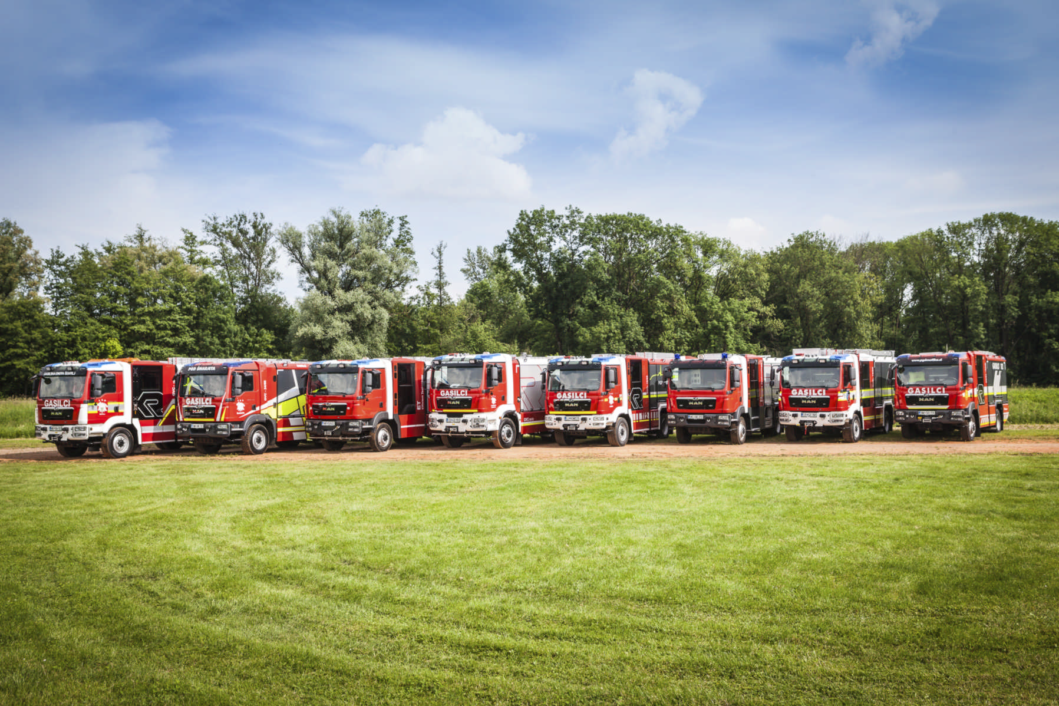
FY 2018 financial figures
Notes:
14

Slide 15
Industry development 2018
In 2018, the world fire fighting market benefitted from a strong global GDP growth showing a robust development
Strongest sales regions were Europe, North America and Asia
Countries highly dependent on the price of oil partially recovered, but procurement volumes are still below historical highs
Demand in North America goes up another 5% and peaks at more than 4,500 vehicles
Higher replacement purchases by the governmental sector
European fire fighting market keeps growing, Germany and Austria more dynamic
Size of Eastern European markets reach historic levels thanks to EU subsidies for infrastructure investments, need to catch up compared to Western Europe persisting
China and India, the largest growth markets in Asia, lower

Slide 16
World firefighting vehicle market 2008-2017
Fire-fighting vehicle market worldwide
Approximate number of vehicles in thousands
Fire-fighting vehicle
market worldwide
Global annual volume
in EUR billion
Rosenbauer Group
Revenues
in EUR million
+6.0% p.a.
+3.4% p.a.
+4.9% p.a.
15
2008
09
10
11
12
13
14
15
16
2017
2008
09
10
11
12
13
14
15
16
2017
2008
09
10
11
12
13
14
15
16
17
2018
Over the last ten years the global firefighting vehicle market has constantly outperformed world GDP, which grew at an annual average rate of 2.8%
In 2017 market volume was about € 4,250 million (2016: € 4,259 million) / 21,100 units (2016: 19,500 units)
Rosenbauer holds market shares of 15% (value) and 10% (units) respectively, being the global market leader

Slide 17
Highlights
In 2018 Rosenbauer Group has resumed its growth path, revenues increased to € 909.4 million
In particular, Western Europe the Near and Middle East saw significantly higher volumes, Stationary Fire Protection as well as Germany and Austria increased
Photo finish: With revenues totaling to € 357.4 million, the last three months of the year proved to be the strongest single quarter in the company´s history
With € 48.8 million EBIT has more than doubled compared to the previous year
High production output and favorable product mix
As expected effects from new accounting standard IFRS 15 have flattened out towards year-end
Record incoming orders of € 1.1 billion allows for excellent utilization capacity forecast in the current year
Distribution policy geared towards sustainability
Dividend proposal of € 1.25 per share reflects the positive 2018 business development
Notes:
17

Slide 18
Revenues and EBIT
€ million
EBIT margin
5.4%
8,3%
7.7%
6.0%
5.7%
5.9%
5.8%
5.4%
2.5%
5.4%

Slide 19
Revenue development
€ million
+7.3%
32.8
6.7
1.0
909.4
Rosenbauer Group 2018 with above-the-market growth
5 out of 6 business segments achieve higher volumes
Area NISA and Area MENA account for the biggest increases
Area APAC influenced by local risks, China and India lower
29.0
-16.2
847.6
8.5
2017
CEEU
MENA
NISA
APAC
NOMA
CEEU
MENA
NISA
APAC
NOMA
SFP
2018
Area Revenue 2018
276.2
105.2
119.0
165.4
219.5
24.2
Group Revenues 2018
30%
12%
13%
18%
24%
3%
Group Revenues 2017
32%
9%
10%
21%
25%
3%

Slide 20
EBIT development
€ million
+131.3%
Earnings improvement thanks to higher output and favorable product mix
2017 EBIT affected by one-offs
Stationary Fire Protection shows negative EBIT as it has not yet reached critical size
4.7
48.8
8.8
2.6
-2.2
-0.6
14.4
21.1
2017
CEEU
MENA
NISA
APAC
NOMA
CEEU
MENA
NISA
APAC
NOMA
SFP
2018
Area EBIT 2018
13.6
8.9
3.5
13.0
11.0
-1.2
Group EBIT 2018
28%
18%
7%
27%
22%
-2%
Group EBIT 2017
-4%
1%
4%
39%
63%
-3%

Slide 21
Revenues and EBIT quarterly
in € million
318.4
219.4
23.4
204.7
183.6
12.8
8,1
4.6

Slide 22
Investments
CAPEX, depreciation and amortization € million
R&D expenses, ratio of R&D expenses to sales € million
CAPEX 2018: 63% growth, 21% replacement, 16% rationalization
Paint shop Leonding, aerials production Karlsruhe, production hall Radgona
Capitalization rate 8.6% (2017: 14.5%)
Series production readiness CFT, 3rd generation of XS aerials from Karlsruhe

Slide 23
Financial figures
€ million | 2016 | 2017 | 2018 | ❒ 2017/2018
Revenues | 870.8 | 847.6 | 909.4 | +7.3%
EBIT | 47.0 | 21.1 | 48.8 | +131.3%
EBIT margin | 5.4% | 2.5% | 5.4% | -
EBT | 44.0 | 21.1 | 43.8 | +107.6%
Net profit for the period | 34.6 | 18.5 | 34.7 | +87,6%
Cash flow from operating activities | 83.4 | 28.4 | -13.7 | -148,2%

Slide 24
Accounting ratios
€ million / % | Dec. 31, 2016 | Dec. 31, 2017 | Dec. 31, 2018 | ❒ 2017/2018
Total assets | 650.6 | 625.4 | 782.3 | +25.1%
Equity ratio | 37.2% | 38.2% | 30.3% | -
Capital employed (ø) | 470.2 | 472.6 | 498.6 | +5.5%
ROCE | 10.0% | 4.5% | 9.8% | -
ROE | 18.8% | 8.8% | 18.4% | -
Net debt | 171.3 | 184.1 | 231.5 | +24.7%
Gearing ratio | 70.8% | 77.0% | 97.6% | -
1
2
Total assets w/o IFRS 15: 734.9 € million (+17.5%)
Equity ratio w/o IFRS 15: 34.7%

Slide 25
Balance sheet structure (in € million)

Slide 26
Trade working capital and financing
Trade Working Capital
€ million
Financing
€ million
TRADE WORKING CAPITAL
€ million
FINANCING
€ million
Long throughput times of 8 to 12 months
Prepayments > 15%
Average payment term of 71 days

Slide 27
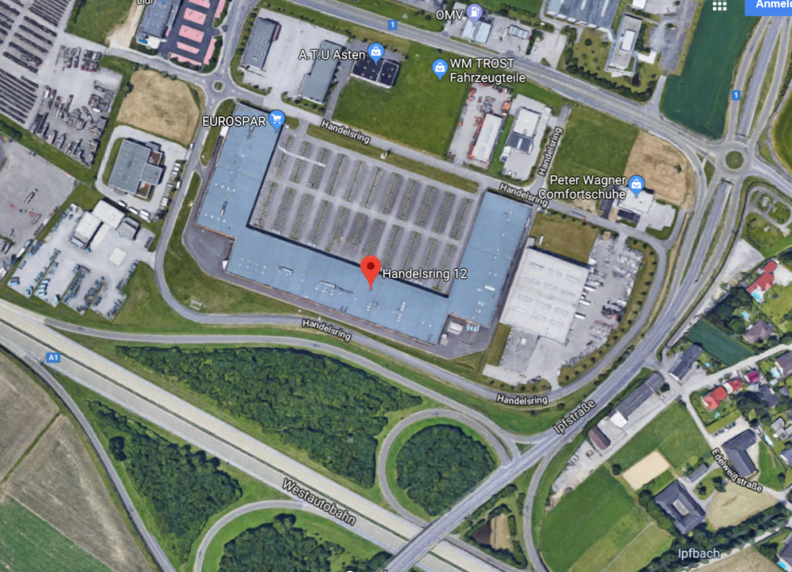
New logistics center Asten
Location: Handelsring 12, 4481 Asten
Warehouse with 4,500 m² total usable area
Traffic-favorable position next to motorway A1
Being put into operation successively from March 2019 on
Handling of SKD / CKD shipments
Move of small- and high-volume packaging
Temporary storage of chassis and finished firefighting vehicles
Relief of Leonding plant 1, which has only a limited storage area, and insourcing of logistics services
Cost-neutral rezoning of Leonding plant 1 unfreezing additional manufacturing capacity of around 200 SKD assembly kits

Slide 28
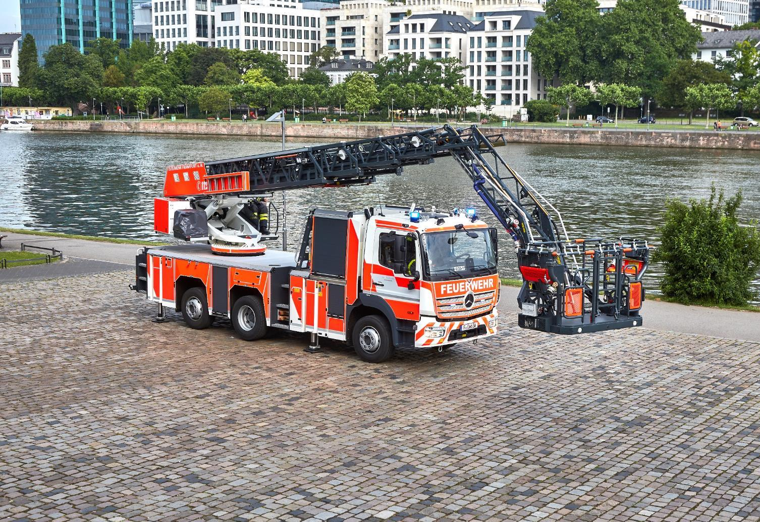
Outlook
Notes:
28

Slide 29
Order intake / backlog
Order intake/backlog € million
Order intake 2018 by Area (2017)
€ 1,107.7 m

Slide 30
Outlook
Global economic growth will slow down in 2019, according to the IMF
Especially the US-China trade dispute, a weakening financial market sentiment and lower economic activity in Germany are a burden
The world fire service market follows with a delay of several months, full order books should make the industry resilient
Procurement volumes in the North American fire service market could again well exceed 4,000 vehicles this year
European fire service market continues to grow, strong demand especially in Austria, Germany, France and the United Kingdom
Near and Middle East with significant recovery
A massive order book supports the high utilisation of capacity of the production sites and gives Rosenbauer Group a strong visibility in the markets
Strategy for organic growth will continue to be implemented consistently, focus on local market shares and increase in efficiency

Slide 31
Dividend proposal and guidance 2019
Rosenbauer Group follows a growth-oriented
and sustainable dividend policy, which reflects its commercial success. Based on net profit and free cash flow the group aims at safe dividend payments. In general the payout ratio should make up 30 to 40% of the net profit attributable to the shareholders of the parent company, unless it is not opposed by other important reasons. Moreover shareholders may participate in an extraordinary positive
development of Rosenbauer Group.
With regards to the fiscal year 2018 the Managing Board and the Supervisory Board are going to propose a dividend of
€ 1.25 per share
to the Annual General Meeting.
GUIDANCE 2019
> 950 Mio €
Group Revenues
~ 5,5%
EBIT Margin

Slide 32
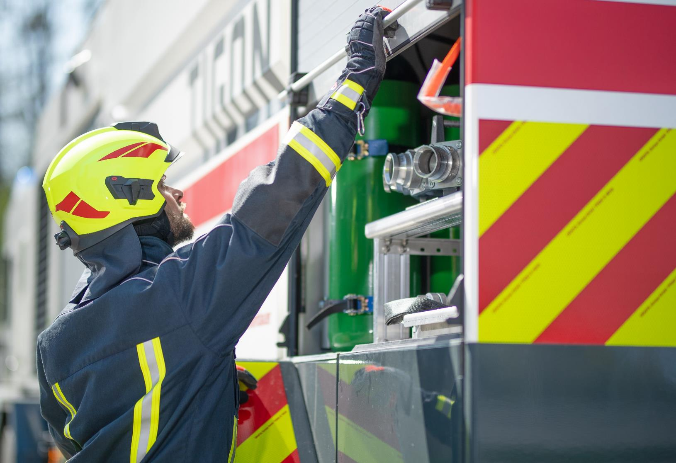

Thank you for your attention!

Slide 33
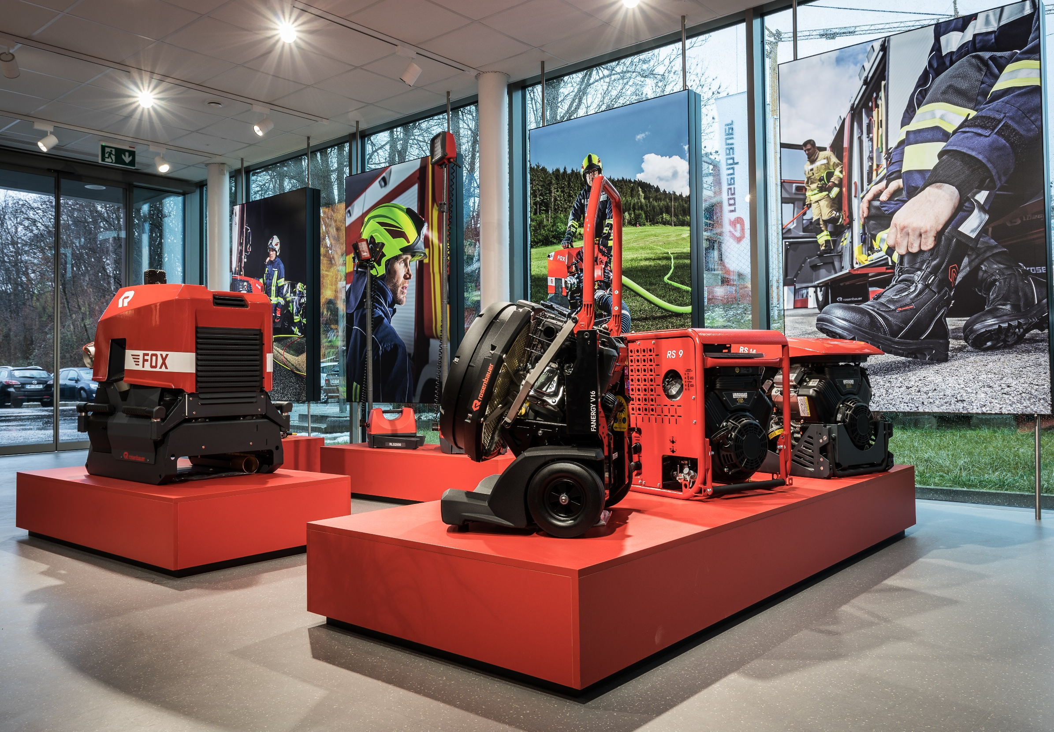
Appendix
Notes:
33

Slide 34
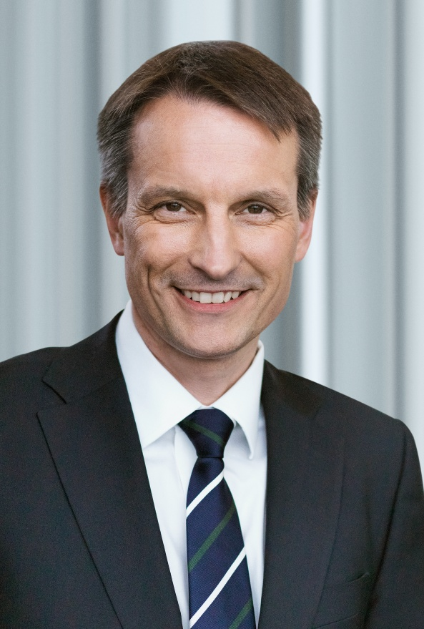
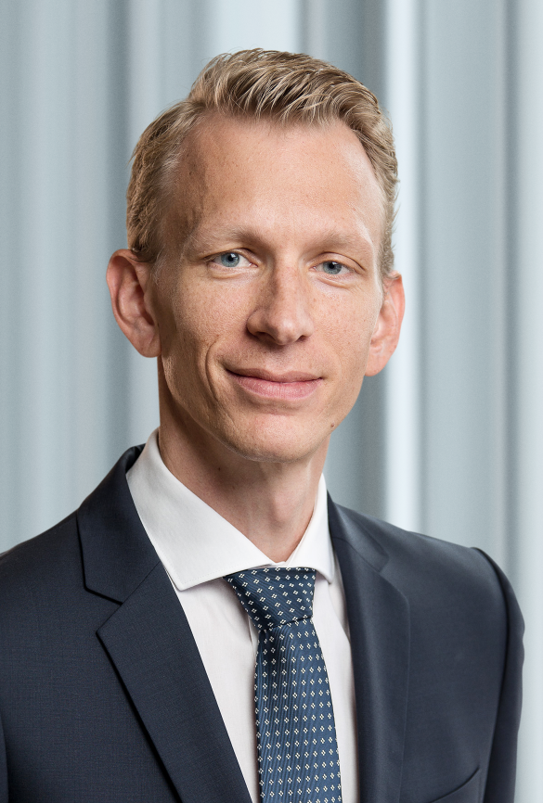
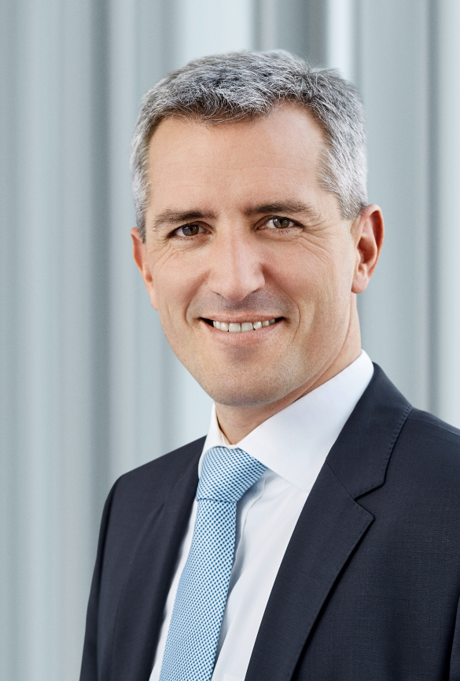
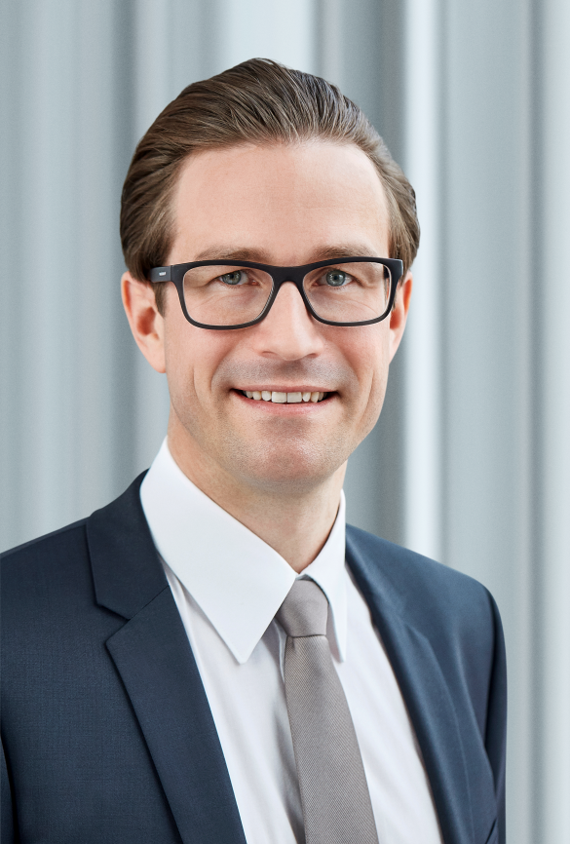
Executive board
CEO
Dieter Siegel
Corporate Development, Human Resources, Strategy, Innovation & Marketing, Group Communication, Fire & Safety Equipment
Product Management
CFO
Sebastian Wolf
Audit, Controlling, Accounting/Tax, Treasury, Legal & Compliance & Insurance, Export Finance, Investor Relations/CSR, IT
CSO
Andreas Zeller
Area CEEU
Area NISA
Area APAC
Area NOMA
Area MENA
Customer Service
Sales Administration
CTO
Daniel Tomaschko
Supply Chain Mgmt., Central Technics, Center of Competence Operations,
Stationary Fire Protection

Slide 35
Using IFRS 15 for the first time - later revenue recognition
(To 31/12/2017)
“Percentage of Completion”
Method
Period-of-time related revenue
recognition in the income statement
according to production status
Aliquot revenues and partial profits in
the income statement
Construction contracts in the balance sheet
Income
statement
Status of construction contract
(From 1/1/2018)
“Completed Contract” Method
Date-related, later sales recognition in the
income statement with delivery
Income statement: Revenues
Inventory, WiP
Result*
Balance sheet: Construction contracts = 0
Inventories
*) through lack of partial profits
Income
statement
t

Slide 36
PoC effects flattening out in line with 12M business cycle
IFRS 15 was first applied in the reporting period under the modified retrospective approach
According to this approach PoC effects need to be presented only in the first year of introduction
With regards to Rosenbauer Group, the new accounting standard is primarily relevant for the production of firefighting vehicles
12M business cycle: First half-year characterised by stockpiling, second half-year by stock reduction
in € mio
1-3/2018
1-6/2018
1-9/2018
1-12/2018

Slide 37
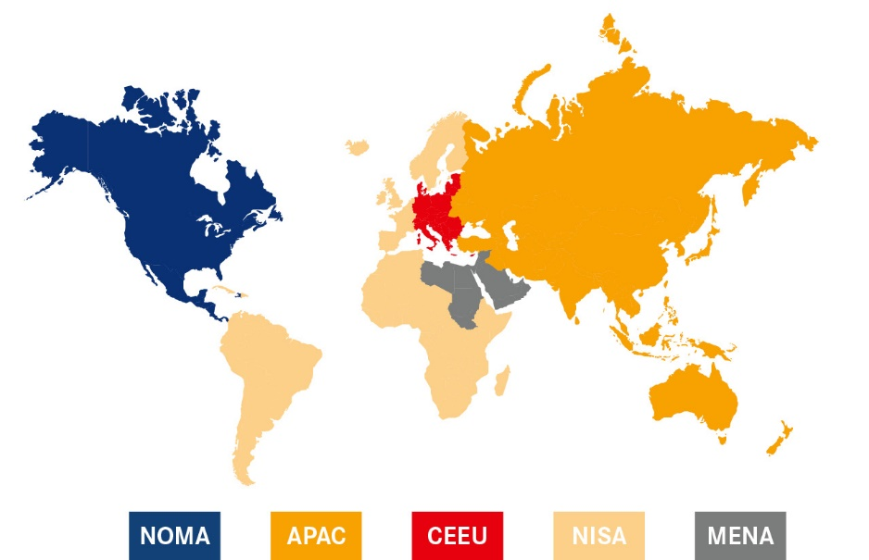
Segment reporting by Areas
CEEU: Central & Eastern Europe
NISA: Northern Europe, Iberia, South America, Africa
MENA: Middle East & North Africa
APAC: Asia, Pacific, Australia, China
NOMA: North & Middle America

Slide 38
Number of employees (reporting date)
3,621
3,405
3,375
3,086
2,941
2,651
In addition, Rosenbauer employs approximately 355 temporary employees.

Slide 39
Rosenbauer share
 |  | 2017 | 2018
Highest price | € | 52.6 | 33.3
Lowest price | € | 51.1 | 31.8
Closing price | € | 52.6 | 33.3
Market capitalization | € million | 357.7 | 226.4
Dividend | € | 1.0 | 1.25¹⁾
Earnings per share | € | 1.1 | 3.7
* Rosenbauer Beteiligungsverwaltung GmbH
¹⁾ Proposal to the Annual Meeting
Indizes: ATPX, AFA, AIGS, AP8, AXGP, NAP8, NTFA, TAP8, TFA, VOX, WBI

Slide 40
Financial calendar 2019
April 5, 2019 | Publication of the results 2018
April 16, 2019 | Roadshow, New York
April 17, 2019 | Roadshow, Toronto
April 18, 2019 | Roadshow, Montreal
May 13, 2019 | Publication of the Interim Statement 1/2019
May 15, 2019 | Roadshow, London
May 23, 2019 | Annual General Meeting
August 9, 2019 | Publication of the Half-year Financial Report 2019
September 23-26, 2019 | Baader Investment Conference, Munich
October 17, 2019 | Family Office Day, Vienna
November 12, 2019 | Publication of the Interim Statement 3/2019

